Slide 1

Does the rise of Winery growth influence Regional dynamics?
Presented by: Eli, Luis, Raquel

Slide 2
Initial considerations
Theory
Winery presence in the US has increased by 58% over the past 10 years. Where has that growth been strong? What impact has it had on local economy, health, crash and population?
Data Limitations
While a broad reach of data is available, limits to free sets at a city/county level across the information being sought proved less available resulting in pulling back to a state level analysis. Similarly, years of available data were not always consistent and restricted some comparisons as a result.
Outcomes
Given time constraints we ultimately focused on 5 of the most well-known wine states for our analysis. While there are some correlations, we found that items we assumed might have stronger links were not directly relevant and others may be more influenced by additional factors we did not have time to review during this project.

Slide 3
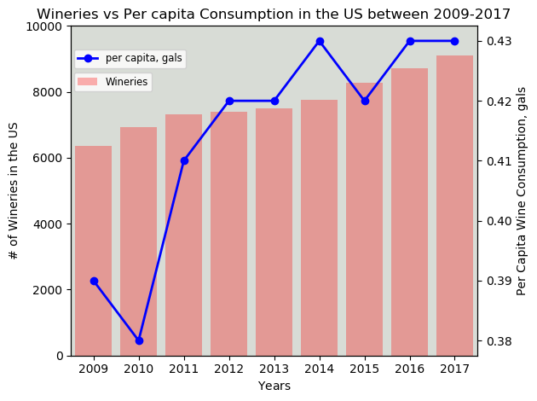
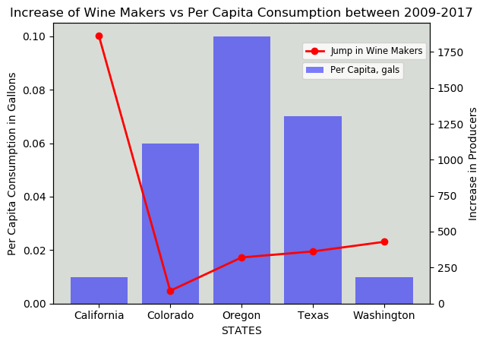
Winery growth and consumption
Fun Facts
The US is the fourth biggest wine producing nation in the Planet, right after France, Spain and Italy
Wine Production in the US dates back to the 16th century, when the French Huguenot settlers made wine in Jacksonville, Florida using Scuppernong grapes
89% of all American wine is produced in California
Data analyzed was narrowed from 2009 to 2017
US consumption per capita rose steadily along with the number of new wineries
On a state-wide basis, the biggest jump in wine producers came from California. However wine consumption per capita in this state saw lowest growth of the considered group
Highest increase in wine consumption per capita appears to occur in Oregon, closely followed by Texas (woo-hoo!!)

Slide 4
Tourism economic impacts

Slide 5
Price Parity/affordability

Slide 6
crash rates

Slide 7
Health implications

Slide 8
summary

Slide 9
Appendix & references

Slide 10
references
Wine & Vines
US Census Bureau
Department of the Treasury, Alcohol, Tobacco Tax and Trade Bureau
National Institute on Alcohol Abuse and Alcoholism
Bureau of Economic Analysis
Centers for Disease Control and Prevention
Kaiser Family Foundation
National Low Income Housing Coalition
National Highway Traffic Safety Administration (API)
Everyvine
VinePair
The preceding analysis was based on data obtained from these sources.
Unless noted, data files were obtained as csv files.

Slide 11
Appendix: Next Steps

Slide 12
Appendix: Unused Charts

